Slide 1
What’s NEW in Visual Studio 2013
David E. Manske

Slide 2
agenda
David Manske and Centare
Getting Started and Environment Dependencies
Demos, Examples, and Samples
Questions – don’t hold ‘em, you’ll forget ‘em.

Slide 3

David E. MANSKE
 @davidemanske
 davidemanske@gmail.com
↑ http://www.linkedin.com/in/davidemanske

Slide 4









What We Do
Agile Transformation
Teams
Executives
Organizations
1
2
Assessment
Training
3
Coaching
Agile Software Delivery
Turnkey
Off Site
On Site
Agile Techniques
ALM
Cloud
3
1
Teams
Scale
Flexibility
Milwaukee
Chicago
Madison
Deep Platform Leadership
2

Slide 5


Slide 6
AT Centare
Team Lead, Scrum Master in Centare’s Development Center
from Baseball to Banking to Logistics and Big Data
Scrum, .NET, Mobile, Native, Non-native, Web, Thick-client, ...

Slide 7
Getting Started
Environment Dependencies

Slide 8
Visual Studio 2013
Visual Studio 2013 w/ Update 1
Ultimate, Premium, Pro
Edition’s Comparisons at http://bit.ly/1bTj1d3
Web Essentials for Visual Studio 2013
http://bit.ly/14GiDI2
SideWaffle File Templates
http://bit.ly/1fJiX1g

Slide 9
ASP.NET
MVC 5
SignalR
Real-Time Apps
Entity Framework
Entity Framework 6 New Features
WEB API 2.0
Web Forms
IDE
Visual Studio Enhancements
ASP.NET Identity
OWIN
Open Web Interface for .NET

Slide 10
DEMO
Let’s just jump in...

Slide 11

Login to the IDE
Sign-In to the IDE to save your Visual Studio Preferences, Editor Changes, and other Shortcut Keys/Macros.
Appearance, Aliases, Keyboard Shortcuts, Startup, Text Editor
Quick Launch: sync

Slide 12
Themes
Light, Dark and Blue (very subtle differences)
support for high-resolution (retina) displays
more colors added to icons in the toolbar and explorer panels
minor color changes within tabs and various other panels
** not very noticeable
Quick Launch: theme

Slide 13
Async Everywhere
Improved performance for loading large, numerous project solutions
Cancelable builds
Async ASP.NET Identity Manager
Async Entity Framework 6

Slide 14
New ASP.NET MVC 5 Changes
Unified ASP.NET
MVC, Web Forms, Web API. (SignalR next?)
Bootstrap Theme 3, out of the box!
Updated Account Controller (UserManager )
In the Preview of 2013, it was AuthenticationIdentityManager and IdentityStore classes. UserManager enhancements in RC.
Async Everywhere.

Slide 15
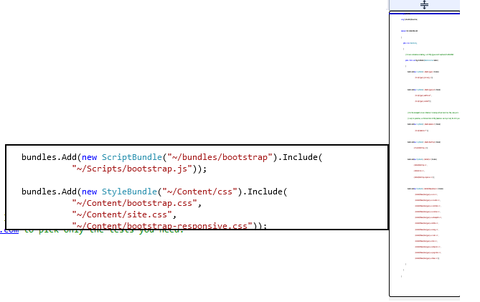
Preview Map for Scrolling
Preview Map for scrolling through code on the scroll bar and a quick preview.
Quick Launch: scroll

Slide 16
Go To vs. Peek Definition
The traditional Go-To-Definition action derails the user from their current context within the file.
Peek Definition gives the developer a preview of the inquired class/type. (Check out the Preview of a Preview)

Slide 17
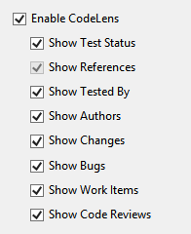
Code Lenses
Show Recent Test Status (Pass/Fail)
Show Tests that involve the object/method
Show References to the method/class/type
Show Code Authors and Check-in Comments
Quick access to view change sets and diff
Quick Launch: codelens

Slide 18
New HTML Editor
Totally revamped HTML editor. The old one had legacy front-page extensions that made forced it be slow.
Added further intellisense for CSS/JavaScript and HTML5 tags.

Slide 19
Zen Coding
You may never use this, but it’s cool.
Example.
div
div>p>strong
div>h1>p>strong
div>h1+h2+h3
lorem
lorem*5
lorem3
ul>li*5>{item number $$$}
div.container>h1>lorem5^+h2>lorem5^+h3>lorem5^+h4>lorem5^+h5>lorem5^+h6>lorem5^+p>lorem^+ul>li*5>lorem3^^+ol>li*5>lorem3^^label>{text}^+input[type="text"]+label>{date}^+input[type="date"]+label>{email}^+input[type="email"]+label>{textarea}^+textarea+input[type="checkbox"]+input[type="checkbox"]+input[type="checkbox"]

Slide 20
Zen Coding Cheat sheet
#
[]
.
Creates an id attribute
Creates a class attribute
Creates a custom attribute
>
Creates a child element
+
Creates a sibling element
^
$
*x
Climbs up in the tree
Multiplied x times
Replace by increment number
$$ or $$$ or $$$$
Creates an auto increment number with fillers (001, 002)
{}
Creates a text element

Slide 21



CSS Intellisense and LESS
CSS Intellisense
Method Overrides
Browser Support and Version
LESS Support
Support for pre-compiling, minifying and bundling.
http://bit.ly/16aA0bH

Slide 22


ANGULARJS and CoffeeScript
AngularJS Intellisense
Nested intellisense options
SideWaffle Templates
Coffee Script JavaScript
Compiles into native JavaScript
Example Compiling

Slide 23
MVC Scaffolding
New ASP.NET MVC Scaffolding
Make your own T4 templates
Views based on Twitter Bootstrap
Create your own Scaffold Template
C:\Program Files (x86)\Microsoft Visual Studio 12.0\Common7\IDE\Extensions\Microsoft\Web\Mvc\Scaffolding\Templates

Slide 24
ASP.NET Identity
ASP.NET Projects support many Auth Types including AzureAD
Claims-based authentication
Support for token based Authentication with Twitter, Facebook, Google, Microsoft or ADFS
OWIN based, again.

Slide 25
Web API 2.0
Support for OWIN Hosting
Attribute Routing
Multiple Actions that respond to the Same Verb
[Route(“auth/something”)]
Versioning
[Route(“api/v1/orders”)]
[Route(“api/v2/orders”)]
Inline Constraints (continued next)

Slide 26
Web API 2.0 Routing
Inline Constraints
Ex. [Route(“orders/{id:int}”)]
Constraint Key | Description | Example
bool | Matches a Boolean value | {x:bool}
datetime | Matches a DateTime value | {x:datetime}
decimal | Matches a Decimal value | {x:decimal}
double | Matches a 64-bit floating point value | {x:double}
float | Matches a 32-bit floating point value | {x:float}
guid | Matches a GUID value | {x:guid}
int | Matches a 32-bit integer value | {x:int}
long | Matches a 64-bit integer value | {x:long}
minlength | Matches a string with the specified minimum length | {x:minlength(4)}
maxlength | Matches a string with the specified maximum length | {x:maxlength(8)}
length | Matches a string with the specified length or within the specified range of lengths | {x:length(6)}, {x:length(4,8)}
min | Matches an integer with the specified minimum value | {x:min(100)}
max | Matches an integer with the specified maximum value | {x:max(200)}
range | Matches an integer within the specified range of values | {x:range(100,200)}
alpha | Matches English uppercase or lowercase alphabet characters | {x:alpha}
regex | Matches the specified regular expression | {x:regex(^\d{3}-\d{3}-\d{4}$)}

Slide 27
Entity Framework 6
Async Query and Save
Testing improvements for the DbContext and DbSet
CodeFirst mapping to Insert/Update/Delete Stored Procedures
Lots of other changes and community contributed improvements
Full List of Changes http://bit.ly/1eSd7Nv
Update-Database -Script -SourceMigration $InitialDatabase

Slide 28
Signalr 2.0
OWIN – the Open Web Interface for .NET
Katana framework
Cross-Domain Support (CORS)
Support for CORS in addition to existing JSONP
Easier unit testing of hubs

Slide 29
Getting Started - Signalr
New ASP.NET Project -> MVC
nuget install-package signalr
Startup.cs add app.MapSignalR();
Add -> New Item SignalR v2 Hub
“ExampleHub”
Change Hello method to “Message(string user, string message)” and Clients.All.message(user, message);

Slide 30
Getting Started - Signalr
In HTML/JavaScript
Add to the head
Include jQuery, SignalR Script and Hub
Add to the end of the body
Connect to Hub, call server methods, handle client side events
View Hub Proxy Classes (~/signalr/hubs)

Slide 31
Browser Link (Artery)
Launch multiple browsers by setting defaults
Works when you “Start without debugging”
Connected Browser
Ctrl-Alt-Enter will refresh connected browsers.
CSS Changes are reflected immediately
“Browser Link Dashboard” – No Extensions Required
Inspect elements on the page to see their location in code.
Edit elements directly in the web browser.

Slide 32
OWIN
Open Web Interface for .NET
http://owin.org
Notes:
The goal of the OWIN interface is to decouple server and application, encourage the development of simple modules for .NET web development, and, by being an open standard, stimulate the open source ecosystem of .NET web development tools.

Slide 33
OWIN MODEL
Application
HttpContext, etc.
Middleware
SignalR
MVC
WebAPI
Custom
OWIN App Builder
Host
OWIN Environment Dictionary
Server

Slide 34
The OWIN Interface
Environment Dictionary
IDictionary<string, object>
owin.RequestPath | string
owin.RequestMethod | string
owin.RequestBody | Stream
owin.RequestHeaders | IDictionary<string, string[]>

Slide 35
Questions
(maybe Answers)

Slide 36
UPCOMING Events
Lunch & Learn – “Dynamic Strategy – Being an Agile Company” by Chad Albrecht
Milwaukee – February 19th, 2014
Chicago – February 20th, 2014
Madison – February 21st, 2014

Slide 37
UPCOMING PUBLIC COURSES
Professional Scrum Master
March 5th-6th, 2014 (held in Milwaukee, WI)
For a list of courses in Chicago & Madison, visit www.centare.com/events

Slide 38
Thank You!

